Slide 1
An CNN-LSTM Attention Approach to Understanding User Query Intent from Online Health Communities
Advisor: Jia-Ling, Koh
Source: 2017 IEEE International Conference on Data Mining Workshops
Speaker: Ming-Chieh, Chiang
Date: 2018/09/04

Slide 2
Outline
Introduction
Method
Experiment
Conclusion

Slide 3
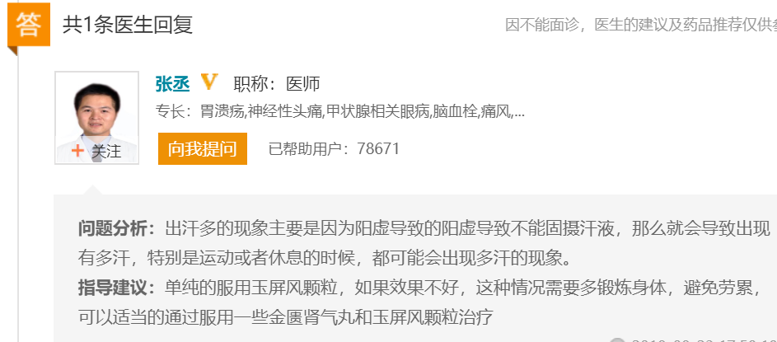
Motivation
Online health community

Slide 4
Goal
Predict user intent in original medical text query
Construct a user intent taxonomy for intent prediction

Slide 5
Definition
d: declared information
e: expected information
Example

Slide 6
Outline
Introduction
Method
Experiment
Conclusion

Slide 7
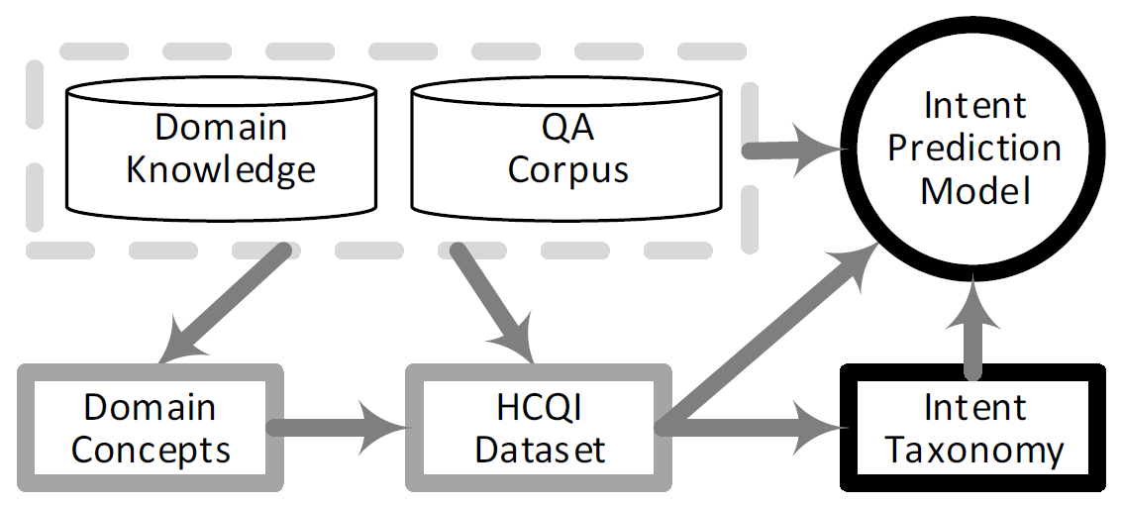
Framework

Slide 8
Method
Mining User Intent Taxonomy
-> Short Sentences Clustering
CNN-LSTM Attention Model

Slide 9
Sentence Clustering
Sentence Pattern Transferring
Word Weight
Short Sentence Representation
DBSCAN Clustering

Slide 10
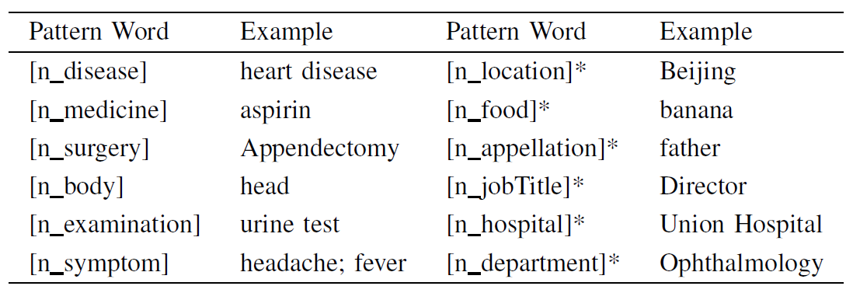
Pattern Transferring
Reduce the diversity

Slide 11
Word Weight

Slide 12
Sentence Representation
Word2Vec
POS tags (noun, verb, adjective, interrogative )

Slide 13
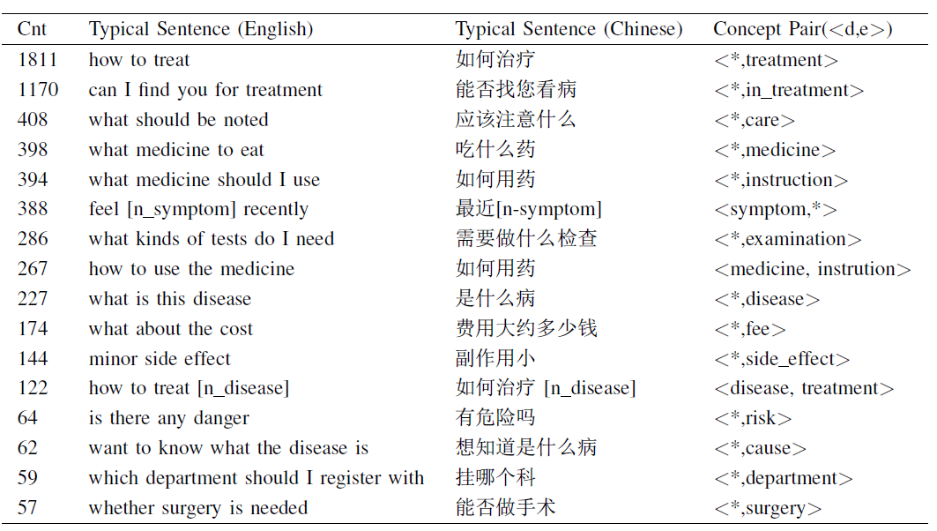
DBSCAN Clustering

Slide 14
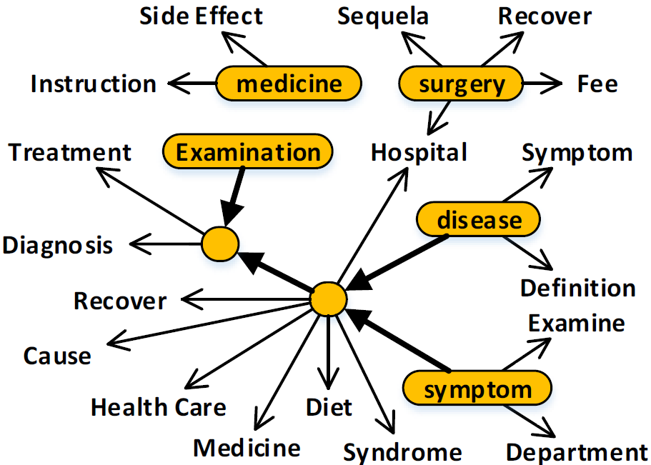
Intent Taxonomy

Slide 15
Method
Mining User Intent Taxonomy
-> Short Sentences Clustering
CNN-LSTM Attention Model

Slide 16
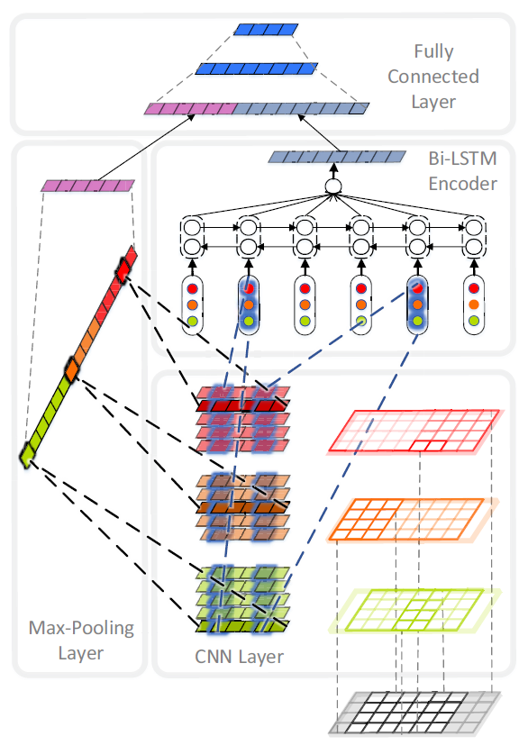
Model

Slide 17
Input Feature Matrix
Word2Vec (skip-gram)
POS tags
NER tags (table I)

Slide 18
CNN Encoder

Slide 19
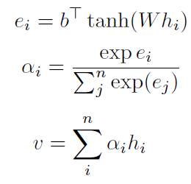
Bi-LSTM Attention Encoder
Bi-LSTM:
Attention:

Slide 20
Joint Layer
Max-Pooling
Layer

Slide 21
Outline
Introduction
Method
Experiment
Conclusion

Slide 22
Data
尋醫問藥 http://www.xywy.com/
20 million QA pairs
272816 words in 12 classes of named entity
HCQI dataset (table III)

Slide 23
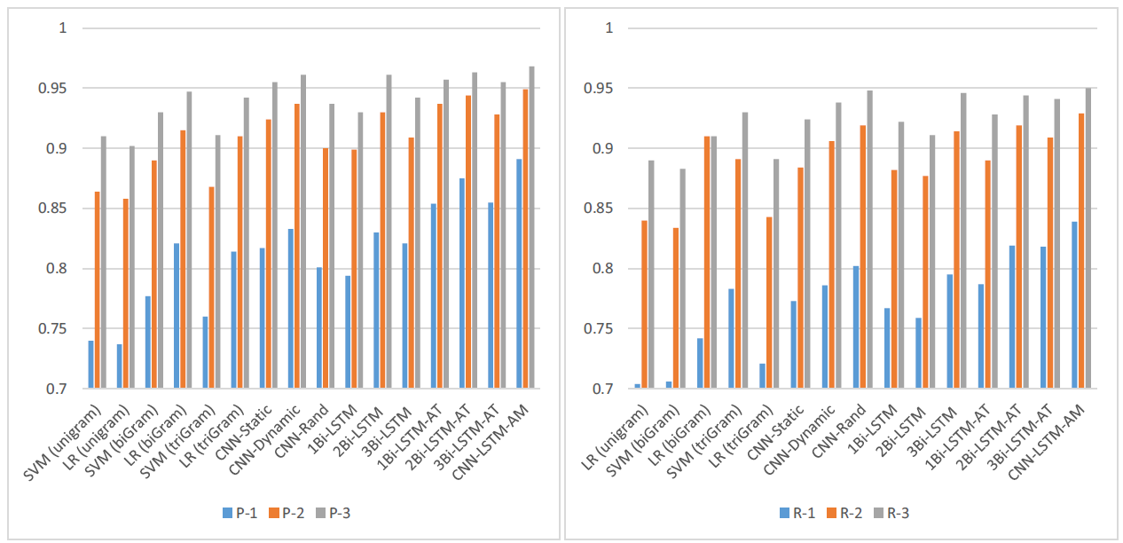
Evaluation

Slide 24
Outline
Introduction
Method
Experiment
Conclusion

Slide 25
Conclusion
A novel query intent prediction model by CNN-LSTM attention for user intent understanding
The neural network have great performance in intent mining task

Slide 26
DBSCAN
DBSCAN is a density-based algorithm.
Density = number of points within a specified radius (Eps)
A point is a core point if it has more than a specified number of points (MinPts) within Eps
A border point has fewer than MinPts within Eps, but is in the neighborhood of a core point
A noise point is any point that is not a core point or a border point.

Slide 27
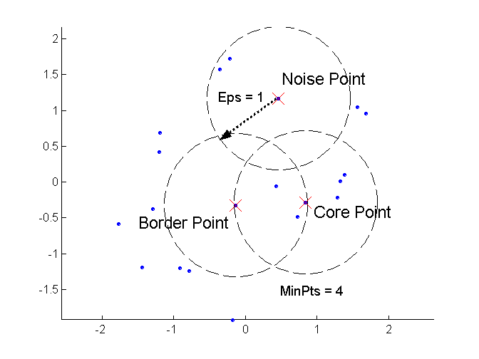
DBSCAN: Core, Border, and Noise Points

Slide 28
DBSCAN: Core, Border, and Noise Points

Slide 29
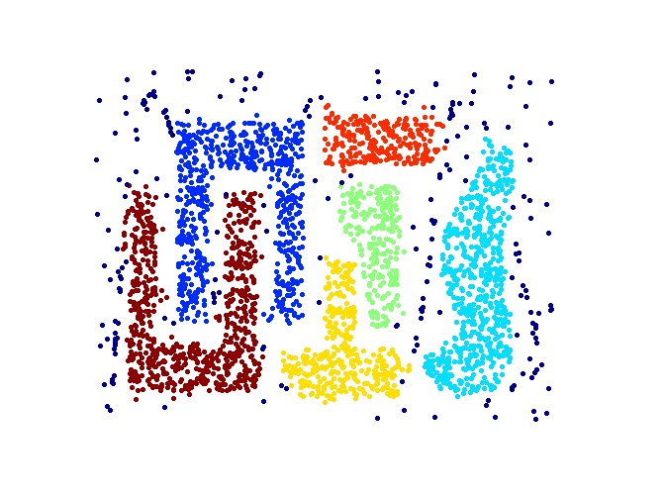
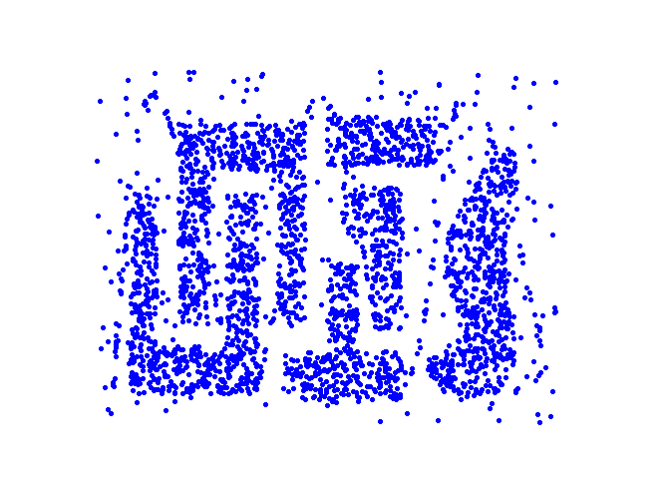
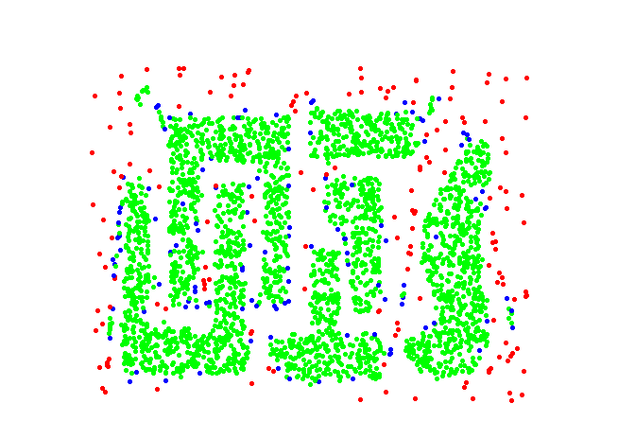
DBSCAN Works
Point types: core, border and noise
Original Points
Clusters

